Slide 1
KeyStone Software Overview Multicore Applications

Slide 2
Keystone II Development Ecosystem
Standard Linux Development Tools
(host or target-based)
Multicore Software Development Kit (MCSDK)
Eclipse IDE
Code Composer
StudioTM (CCS)
Third Party
Plug-Ins
Host Computer
Target Board/Simulator
Emulator

Slide 3
MCSDK Overview
Set of software building blocks to facilitate development of applications
DSP and ARM platform software, low-level drivers, high-level APIs and other utilities
Source and prebuilt libraries are included
Embedded OS: SYS/BIOS RTOS on C66; Linux on ARM
Development OS: Windows and Linux PC support
Free to download with all components in one installer
Notes:
Enables faster time to market and is easy to use
MCSDK consists of:
- SYS/BIOS which is a light-weight real-time embedded operating system for TI devices
- Chip support libraries, drivers, and basic platform utilities
- Interprocessor communication for communication across cores and devices
- Basic networking stack and protocols
- Optimized application-specific and application non-specific algorithm libraries
- Debug and instrumentation
- Bootloaders and boot utilities
- Demonstrations and examples

Slide 4
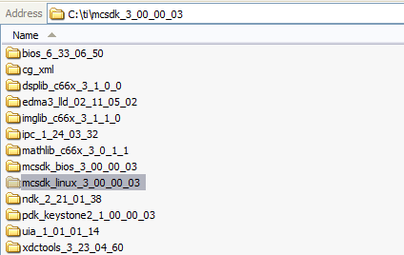
MCSDK Overview

Slide 5
C66x Perspective
Out-of-Box Demonstration Applications and Examples
Software Framework Components
Communication Protocols
SYS/BIOS
RTOS
Interprocessor
Communication
Instrumentation
(MCSA)
TCP/IP
Networking
(NDK)
Algorithm Libraries
Platform/EVM Software
DSPLIB
IMGLIB
MATHLIB
Platform
Library
Transports - IPC - NDK
Low-Level Drivers (LLDs)
SA
RM
BCP
TCP3D
10GbE
Resource
Manager
POST
EDMA3
PA
SRIO
FFTC
TSIP
OSAL
Bootloader
PCIe
QMSS
CPPI
HyperLink
…
Chip Support Library
Hardware
KII LLD
Notes:
Driver support and platform software is available on the DSP side for CPPI, HyperLink, Packet Accelerator, PCI Express, QMSS, SRIO, and now an extension of the resource management LLD for both ARM and DSP resource management, as well as support for the security accelerator and 10 gigabit Ethernet. The chip support library provides support for PLL, PSC, DDR3, Interrupts, and EDMA3 low-level configurations.

Slide 6
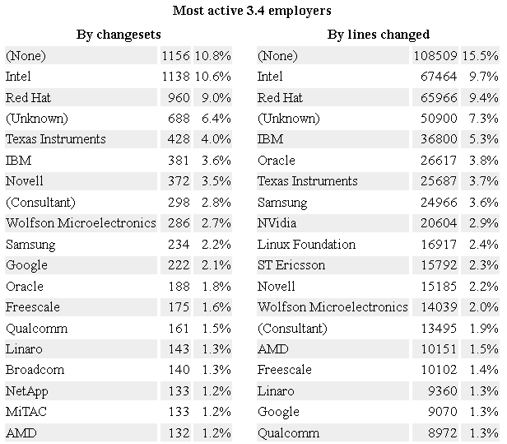



TI Open Source Presence: Linux
Active member of Linux Foundation
Founding member of Linaro
Sponsor of BeagleBoard and PandaBoard; top open hardware and open embedded software projects
Source http://lwn.net/Articles/496193/
Notes:
TI has a strong open source presence as an active member of the Linux foundation and a founding member of Linaro. TI has sponsored BeagleBoard and PandaBoard, the top open hardware and OpenEmbedded software projects. As this table illustrates, TI is one of the top 10 contributors to the Linux kernel and leads the embedded processing industry in the number of contributions to the open source community.

Slide 7
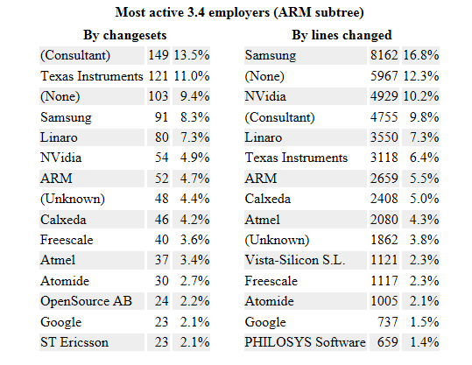
TI Open Source Presence: ARM
Source http://lwn.net/Articles/496193/

Slide 8
ARM Linux: Overview
Linux-based software platform for development, deployment, and execution of ARM A15 on KeyStone II.
Actively upstreaming Keystone II support to the open-source community
Source code and prebuilt images of u-boot and kernel
Open-source Linaro toolchain for compilation (gcc) and debug (gdb)
Load-and-run Linux kernel using Code Composer Studio
Telnet into device to view console print as device boots and to mount root filesystem
Notes:
8
Linux-based software platform for development deployment and execution of ARM A15 on Keystone II is available from TI as part of the MCSDK. TI has actively upstreamed Keystone II support to the open source community, and both source code and prebuilt images of u-boot and kernel are available both as part of the MCSDK and online in the open source community. The open source Linaro toolchain is used for compilation using GCC and debug using the GDB debugger. Developers can load and run the Linux kernel using the Code Composer Studio IDE and Telnet into the device to view console prints as the device boots and mounts its root filesystem.

Slide 9
ARM Linux: Overview
Development Tools
Build
ARM toolchain - Linaro
Optimized for Cortex-A15
GCC 4.6 based
Debug
Code Composer Studio: Eclipse IDE, Linux aware debug, GDB Integration
On Target: GDB, Valgrind, and most standard Linux tools
Optimize
Code Composer Studio: Integrated profiling and trace tools
On Target: O-Profile, Gcov, Gprof, GDB Trace Points
Linux Platform Software
Boot
U-Boot(/SPL) Support
Boot Modes (SPI, NAND, …)
Network boot
Kernel
Linux 3.6+, to be upstreamed
Distribution
Arago:
Target Applications
Packet Processing
Datacenter/Enterprise
SMP Support, Full set of drivers
Community aligned, Unified kernel
6WINDGate
Multimedia/HPC
VDI
Video transcode
Many node cluster
Transport network data path applications
Data center and network appliances
Enterprise gateway
HPC DSP Accl. (linpack, multicore- FFT)
OpenEmbedded based
Yocto Aligned
Notes:
Let's look at the ARM Linux perspective from three angles.
Development tools
We use the Linaro ARM toolchain for building applications on the ARM side for Keystone II. The Linaro ARM toolchain is optimized for the Cortex-A15 and is based on the 4.6 GCC specification with support for 4.7 in the works.
Debug support is incorporated within Code Composer Studio and Linux aware debug makes it possible to run debug applications on board the DSP side and the ARM side within the same environment. On the target, the GDB debugger is supported and Valgrind (for memory-related debugging) and most standard Linux tools also have support.
In addition to the integrated profiling and trace tools that are part of Core Composer Studio, developers also have the option to leverage the standard O-profile and Gprof, and GDB based trace points to minimize cycle count and optimize their application.
Linux Platform Software
Linux platform software that is part of the MCSDK includes the U-boot bootloader with both the source code and the prebuilt u-boot image part of the MCSDK. Boot modes supported include SPI, NAND, and network boot, and relevant tools for boot support are also incorporated within the MCSDK.
Keystone II support has been integrated into the Linux 3.6 kernel. With TI being community aligned, a unified upstreaming process makes sure that feature additions and modifications are directly sourced back to the Linux kernel tree. The Linux kernel includes symmetric multiprocessing, or SMP support, including features that enhance SMP scalability and the speed of operations for parallel processing systems.
The distribution that we've chosen for Linux and Keystone II is the Arago distribution, which is based on OpenEmbedded and is Yocto aligned. I'll spend a few minutes describing both OpenEmbedded and Yocto, and why TI chose to go this path. OpenEmbedded is a build environment that provides a methodology to reliability build customized Linux distributions using recipes and configurations that allow us to choose the right set of components that are relevant for our device and to our customers. OpenEmbedded also ensures that a compatible combination of bootloader, kernel, libraries, and development tools are integrated into the package, ensuring that developers receive a reliable package with components that work well together. The Arago distribution that we use for Keystone II is also Yocto aligned. The Yocto project is an open source collaboration project that provides templates, tools, and methods to help create custom Linux based systems for embedded products. Yocto is developed and maintained by many industry leaders. So distributions like Arago that are Yocto aligned need to ensure a minimum level of standardization.
Target Applications
The availability of the ARM A15 on Keystone II and SMP Linux running on the processor is attractive for many target applications. Packet processing and transport network data path applications is one such example. 6WINDGate is an example of a popular commercially available software-defined networking solution that provides networking functions and mobile and cloud infrastructure equipment. The availability of the ARM A15 and SMP Linux running on the core, coupled with the signal processing capabilities of the C66x core makes it possible to deploy 6WINDGate’s solution in an optimized and efficient way on TI's Keystone II SOCs. The availability of Linux on the ARM A15 is also relevant for video transcoding and other multimedia applications. High performance compute, DSP acceleration with Linpac and multicore-FFD, as well as data center and enterprise applications with many node clusters can also be efficiently deployed on Keystone II.

Slide 10
ToolChain
Linaro (ARM)
Linaro releases optimized toolchains for recent ARM CPUs (Cortex A8, A9...). These include Linaro's latest contributions to mainline gcc, but backported to stable gcc versions for immediate use by product developers. Linaro actually hires CodeSourcery people to improve ARM toolchains, so the ARM toolchains that you get with Linaro should be at least as good as the CodeSourcery ones.
Native toolchains are available through the standard gcc toolchain in Ubuntu. Cross toolchains are available to Ubuntu users through special packages

Slide 11
Debug
GDB can do four main kinds of things (plus other things in support of these) to help you catch bugs in the act:
Start your program, specifying anything that might affect its behavior.
Make your program stop on specified conditions.
Examine what has happened, when your program has stopped.
Change things in your program, so you can experiment with correcting the effects of one bug and go on to learn about another.
I see Valgrind as a simulator
Valgrind is in essence a virtual machine using just-in-time (JIT) compilation techniques, including dynamic recompilation. Nothing from the original program ever gets run directly on the host processor. Instead, Valgrind first translates the program into a temporary, simpler form called Intermediate Representation (IR), which is a processor-neutral, SSA-based form. After the conversion, a tool (see below) is free to do whatever transformations it would like on the IR, before Valgrind translates the IR back into machine code and lets the host processor run it. Even though it could use dynamic translation (that is, the host and target processors are from different architectures), it doesn't. Valgrind recompiles binary code to run on host and target (or simulated) CPUs of the same architecture.

Slide 12
Optimization
OProfile - system-wide statistical profiling tool for Linux. Written by John Levon in 2001 for Linux kernel version 2.4 after his M.Sc. project.^{[1]} Consists of kernel module, user-space daemon and several user-space tools.
This tool is capable of profiling entire system or its parts, from interrupt routines or drivers, to user-space processes. It has low overhead.
Gcov is a source code coverage analysis and statement-by-statement profiling tool. Gcov generates exact counts of the number of times each statement in a program is executed and annotates source code to add instrumentation. Gcov comes as a standard utility with GNU CC (GCC) suite.^{[1]}
The gcov utility gives information on how often a program executes segments of code.^{[2]} It produces a copy of the source file, annotated with execution frequencies. The gcov utility does not produce any time-based data and works only on code compiled with GNU CC. It is not compatible with any other profiling or test coverage mechanism.[
gprof is a performance analyzing tool in Unix. It uses a hybrid of instrumentation and sampling ^{[1]} and is an extension of older "prof" Unix tool. Unlike prof, gprof is capable of limited call graph printing.[

Slide 13
U-Boot and SPL
U-Boot is a universal boot loader for embedded boards based on PowerPC, ARM, MIPS and several other processors, which can be installed in a boot ROM and used to initialize and test the hardware or to download and run OS and application code.
serial console support
integrated shell alike setup interface
optional password protectection and timeout for acces to setup interface on boot
editable configuration space
downloads software trough tftp servers
flash routines for EEPROMS of misc technology including NANDs
runs test applications directly
boots Linux
X-loader up-streaming(SPL) -
The idea is to build a mini u-boot out of the u-boot tree that fits into SRAM and bootloads the real u-boot into the SDRAM.
The SPL support the following when up-streamed
Basic ARM initialization
UART console initialization
Clocks and DPLL locking (minimal)
SDRAM initialization
Mux (minimal)
MMC initialization(MMC1/MMC2 based on where we are booting from)
Bootloading real u-boot from MMC and passing control to it.

Slide 14
Linux SMP (Symmetric Multiprocessors)
Symmetric multiprocessing (SMP) involves a multiprocessor computer hardware architecture where two or more identical processors are connected to a single shared main memory and are controlled by a single OS instance. Most common multiprocessor systems today use an SMP architecture. In the case of multi-core processors, the SMP architecture applies to the cores, treating them as separate processors.
SMP systems are tightly coupled multiprocessor systems with a pool of homogeneous processors running independently, each processor executing different programs and working on different data and with capability of sharing common resources (memory, I/O device, interrupt system and so on) and connected using a system bus or a crossbar.

Slide 15
Distribution
Yocto
The Yocto Project™ is an open source collaboration project that provides templates, tools and methods to help you create custom Linux-based systems for embedded products regardless of the hardware architecture. The Yocto Project includes core system component recipes provided by the OpenEmbedded project. Community-tested images include the Yocto Project kernel and cover four build profiles (minimal, sato, sdk and LSB) across multiple architectures including ARM, PPC, MIPS, x86 and x86-64. Specific platform support takes the form of Board Support Package (BSP) layers for which a standard format has been developed.
Arago
Arago Project is an open integration, build, and test infrastructure that provides a portal into how Texas Instruments creates customer ready Linux SDKs for their media processors.
Arago Project is an overlay for OpenEmbedded, which targets TI platforms OMAP (EVM and BeagleBoard) DaVinci and KeyStone and provides a verified, tested and supported subset of packages.

Slide 16
Applications
6WINDGate™ is the only commercial software solution that solves critical network performance challenges for OEMs delivering advanced networking functions in SDN markets such as mobile infrastructure, network appliances and data center networking
Virtual desktop infrastructure (VDI) is the practice of hosting a desktop operating system within a virtual machine (VM) running on a centralized server. VDI is a variation on the client/server computing model, sometimes referred to as server-based computing. The term was coined by VMware Inc.
Data Center
High-density, multicore server hardware
• Virtualization of servers and storage
• High-bandwidth networks
• Scalable cloud computing architectures
• Network convergence
• Ethernet fabrics

Slide 17
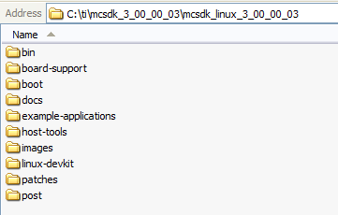
ARM Linux: Folder Contents
Notes:
17
Here is a sneak peak into the MCSDK Linux folder that is installed as part of the MCSDK installation. Here we see the availability of Linux host tools, images for u-boot and the kernel, source code for u-boot and the kernel, and the Linux development kit, along with other tools relevant for ARM A15 Linux development

Slide 18
ARM Linux: U-Boot
Based on the Universal Boot Loader public project
Program that moves executable from non-volatile memory to memory and then transfers CPU control to the newly “loaded” executable
Minimal drivers during U-boot
SPI
I2C
UART
NAND
ETH
USB

Slide 19
ARM Linux : Boot
ROM Boot Loader (RBL) loads Secondary Program Loader (SPL) from SPI NOR flash
SPL loads and run the second stage boot loader (full version of U-Boot) from NOR or NAND
Keystone II – SPI boot mode
The first 64K of the SPI NOR flashed with SPL
Followed by U-Boot image
Notes:
For keystone II, RBL loads SPL image from offset 0 of the SPI NOR flash in spi boot mode. The first 64K of the SPI NOR flash is flashed with SPL followed by u-boot.img.

Slide 20
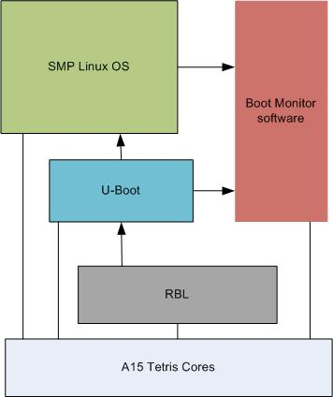
ARM Linux: Boot
Notes:
The basis of the TrustZone model is that the computing environment splits into two isolated worlds, the Secure world and the Non-secure world, with no leakage of Secure data to the Non-secure world. Software Secure Monitor code, running in the Secure Monitor Mode, links the two worlds and acts as a gatekeeper to manage program flow. A Secure Monitor Call (SMC) is used to enter the Secure Monitor mode and perform a Secure Monitor kernel service call.
Boot Monitor software provides secure privilege level execution service for Linux kernel code through SMC calls. ARM Cortex A15 requires certain functions to be executed in the PL1 privilege level, and Boot Monitor code provides this service
After Boot Monitor is installed, Linux kernel booted on primary core
Primary core makes SMC call t

Slide 21
ARM Linux: Drivers & Platform Software
Peripherals:
Multicore Navigator, SRIO, SPI, UART, USB 3.0, I2C with EEPROM, GPIO, EMIF16 – NAND Flash, PLL & PSC, Ethernet subsystem - 1G Switch and NetCP
Semaphore:
Using Linux hardware spinlock
Interrupt Configuration:
Generic Interrupt Controller (GIC) using Linux IRQ API for ARM
External Memory:
LPAE support for DDR3A to access more than 2GB of DDR3A
Booting into both DDR3A and DDR3B supported
Debug and Trace:
Performance Monitoring Unit (PMU) and oprofile support
Notes:
Driver and platform software on the ARM side includes peripheral support for Multicore Navigator, Serial Rapid IO, SPI, UART, USB 3.0, I2C, GPIO, EMIF16, PLL and PSC, and the Ethernet subsystem.
Semaphore support using the standard Linux hardware spinlock framework enables synchronization and mutual exclusion between the ARM and DSP.
The configuration of interrupts is supported via the Generic Interrupt Controller Interface using the Linux IRQ APIs for ARM. The Generic Interrupt Handling layer is designed to provide a complete abstraction of interrupt handling for device drivers. The device drivers use generic API functions to request, enable, disable, and free interrupts. This interrupt hardware abstraction makes it possible for these driver APIs to be used on different platforms without code changes.
With respect to external memory, the platform software brings in LPAE or large physical address extension support for DDR3, making it possible to access more than 2GB of DDR3A up to 8GB of DDR3A. Booting via both the DDR3A and DDR3B are supported.
With respect to debug and trace, the ARM's Performance Monitoring Unit, or PMU, is leveraged to measure micro architectural events such as the number of cycles, cache misses, and other profiling factors. O-Profile and gprof support is also integrated. Gprof is the GNU profiler and is typically leveraged for profiling a given program. Oprofile, on the other hand, is a system level profiler and includes the kernel itself in its calculations.

Slide 22
ARM Linux: Drivers
GIC IRQ chip driver
KeyStone IPC IRQ chip driver
SMP
AEMIF driver
NAND driver
SPI and SPI NOR flash drivers
I2C and EEPROM drivers
KeyStone GPIO driver
KeyStone IPC GPIO driver
Network driver (NETCP), PKTDMA, Packet Accelerator
SGMII driver
QoS driver
USB driver
10Gig Ethernet driver (not validated due to test hardware)
PCIe driver

Slide 23
Drivers & Platform Software Summary
Module | DSP (CSL) | DSP (LLD) | ARM (CSL) | ARM (User Mode LLD) | ARM (Linux kernel)
Timer64 | x |  | x
ARM Arch Timer |  |  |  |  | x
ARM Intc (GIC) |  |  | x |  | x
CPINTC | x |  | x
CPSW (5-port 10G) | x |  | x |  | x
USB 3.0 | x |  | x |  | x
GPIO | x |  | x |  | x
EMIF16 - NAND | x |  | x |  | x
I2C | x |  | x |  | x
USIM | x |  | x |  | x
UART | x |  | x |  | x
SPI | x |  | x |  | x
AIF2 | x | x
SRIO | x | x | x |  | x
PCIe | x | x | x |  | x
PA | x | x | x | x | x
SA | x | x | x | x | x
CPSW (5-port 1G) | x |  | x |  | x
QMSS + PktDMA | x | x | x | x | x
RAC | x
TAC2 | x
VCP2 | x
TCP3D | x | x
BCP | x | x
FFTC | x | x
EDMA | x | x
HyperLink | x | x | x | x
HW Semaphore | x |  |  |  | x
PSC |  |  |  |  | x
Notes:
The table on this page summarizes the drivers and platform software available for Keystone II on both the DSP and ARM side. You'll notice that there are five columns, two columns for the DSP configuration and three columns for the ARM configuration. The first column for the DSP configuration is possibility of configuring that module using the chip support library. The second column is for configuring the module using the DSP low-level drivers. On the ARM side, you could configure the peripheral using the chip support based library on the ARM side, or user mode low-level drivers, or kernel drivers.

Slide 24
Getting Started: Docs & Software
K2EVM-HK (Check Hardware Setup Guide to verify the latest BMC updates)
http://processors.wiki.ti.com/index.php/EVMK2H_Hardware_Setup
MCSDK User Guide (specifically Getting Started & Exploring sections)
http://processors.wiki.ti.com/index.php/MCSDK_User_Guide_for_KeyStone_II
Download MCSDK:
http://software-dl.ti.com/sdoemb/sdoemb_public_sw/mcsdk/latest/index_FDS.html
Ubuntu Linux 12.04 LTS machine

Slide 25
Getting Started: Installation
Install CCSv5.3.0 at <CCS default Installed Directory>. For processor architecture, make sure "C66x DSP + ARM processors" is selected.
Install TI KeyStone II Emupack: ti_emupack_keystone2_setup_1.0.0.2 NOTE: If installed on Linux, replace \ with / in this file /opt/ti/ccsv5/ccs_base/common/targetdb/devices/TCI6638.xml
Install MCSDK 3.00.00.09 to the same directory as CCS, e.g.: /opt/ti
Copy the file tci6638-evm.ccxml from mcsdk_linux_3_00_00_09/host-tools/loadlin folder to ~/<user>/ti/CCSTargetConfiguration folder where CCS saves the user-specific configuration file.

Slide 26
Getting Started: Prerequisites
Toolchain installation: Download the gcc-linaro-arm-linux-gnueabi-2012.03-20120326_linux.tar.bz2 from https://launchpad.net/linaro-toolchain-binaries/trunk/2012.03
cd ~/
tar xjf gcc-linaro-arm-linux-gnueabi-2012.03-20120326_linux.tar.bz2
export CROSS_COMPILE=arm-linux-gnueabi-
export ARCH=arm
PATH=$HOME/gcc-linaro-arm-linux-gnueabi-2012.03-20120326_linux/bin:$PATH
Configure the git and install packages required at build time:
sudo apt-get install git-core
sudo apt-get install build-essential subversion ccache sed wget cvs coreutils unzip texinfo docbook-utils gawk help2man diffstat file g++ texi2html bison flex htmldoc chrpath libxext-dev xserver-xorg-dev doxygen bitbake uboot-mkimage libncurses5-dev

Slide 27
Getting Started
Either use pre-built images or build U-boot, boot monitor, kernel & file system on your own.
Supported file systems:
Ramfs
Net-mounted file system
UBIFS NOTE: Configure environment variables per user’s guide.
Get kernel & file system to boot
Run applications
Notes:
The Unsorted Block Image File System (UBIFS) is a successor to JFFS2,

Slide 28
Getting Started: Planned Demos
Keystone I & II demos:
Utility Application Demo
Known as HUA demo
Provides system information (OS version, CPU info, network interfaces), system statistics (Memory/CPU usage, TX/RX packets), Flash NAND/EEPROM, etc.
Image Processing Demo
Image edge detection
Keystone II demos:
IPC Demo
Load DSP out file from ARM and perform ARM-DSP communication
Transport Net Demo
NETCP capabilities including PA, SA, and Ethernet Switch Subsystem
Notes:
28
In case of Keystone 2, there will be a GUI-based Matrix application launcher

Slide 29
For More Information
Software downloads and device-specific Data Manuals for the KeyStone II SoCs can be found at TI.com/multicore.
For articles related to multicore software and tools, refer to the Embedded Processors Wiki for the KeyStone Device Architecture.
For questions regarding topics covered in this training, visit the support forums at the TI E2E Community website.

